Slide 1
Chapter 3: Network Access
Network Access
Notes:
Cisco Networking Academy program
Introduction to Networks
Chapter 4: Network Access

Slide 2
Chapter 3: Objectives
Students will be able to:
Explain how physical layer protocols and services support communications across data networks.
Build a simple network using the appropriate.
Explain the role of the data link layer in supporting communications across data networks.
Compare media access control techniques and logical topologies used in networks.
Notes:
2

Slide 3
Chapter 3
3.1 Physical Layer Protocols
3.2 Network Media
3.3 Summary
Notes:
Chapter 4 Sections

Slide 4
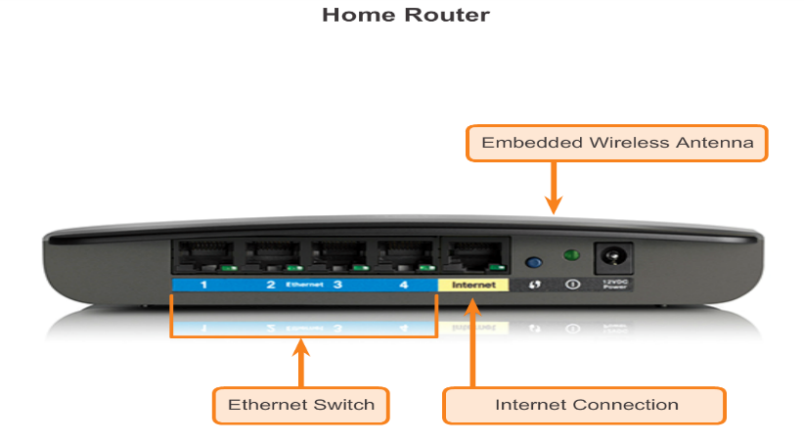
Getting it Connected Connecting to the Network
Notes:
Section 4.1.1.1

Slide 5
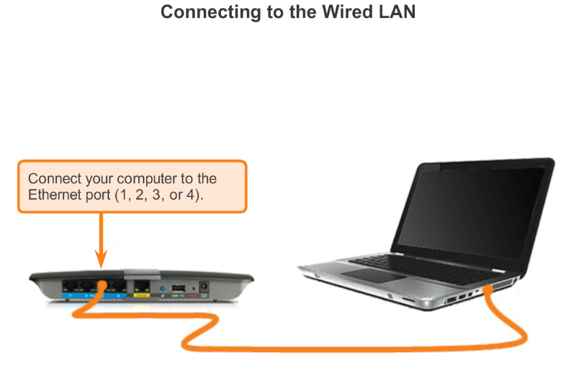
Getting it Connected Connecting to the Network
Notes:
Section 4.1.1.1

Slide 6
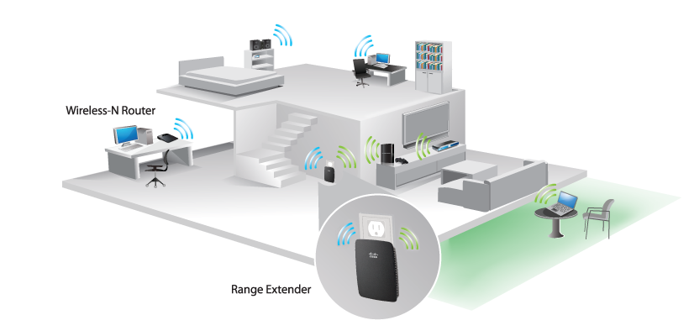
Getting it Connected Network Interface Cards
Connecting to the Wireless LAN with a Range Extender
Notes:
Section 4.1.1.2

Slide 7
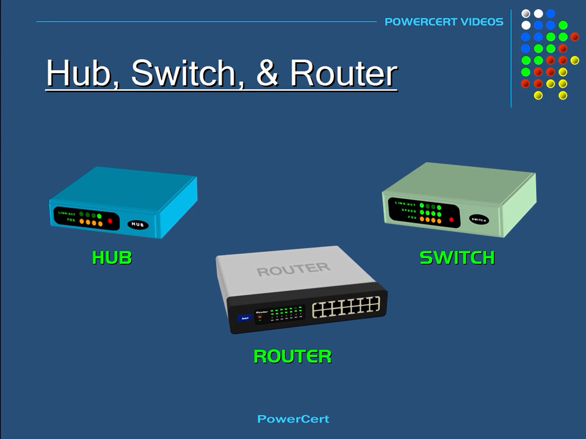
Hub, Switch, & Router – Video
Notes:
Chap3-Hub, Switch, & Router Explained - What's the difference

Slide 8
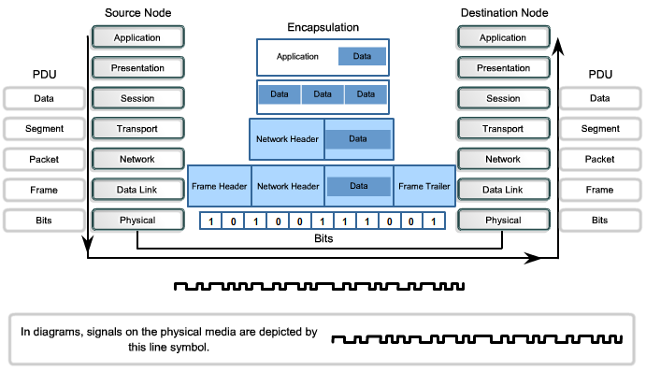
Purpose of the Physical Layer 3.1 Physical Layer Protocol
Notes:
Section 4.1.2.1

Slide 9
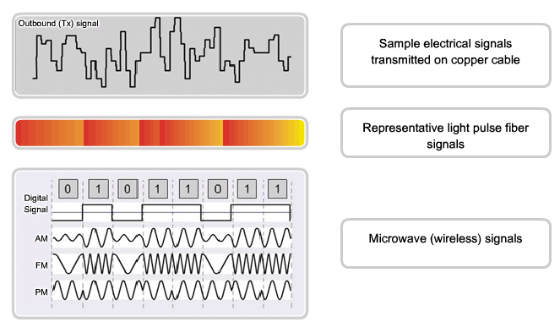
Purpose of the Physical Layer 3.1 Physical Layer Protocol
Notes:
Section 4.1.2.2

Slide 10
Purpose of the Physical Layer 3.1 Physical Layer Protocol
Standard organization | Networking Standards
ISO | ISO 8877: Officially adopted the RJ connectors (e.g., RJ-11, RJ-45) ISO 11801: Network cabling standard similar to EIA/TIA 568.
EIA/TIA | TIA-568-C: Telecommunications cabling standards, used by nearly all voice, video and data networks. TIA-569-B: Commercial Building Standards for Telecommunications Pathways and Spaces TIA-598-C: Fiber optic color coding TIA-942: Telecommunications Infrastructure Standard for Data Centers
ANSI | 568-C: RJ-45 pinouts. Co-developed with EIA/TIA
ITU-T | G.992: ADSL
IEEE | 802.3: Ethernet 802.11: Wireless LAN (WLAN) & Mesh (Wi-Fi certification) 802.15: Bluetooth
Notes:
Section 4.1.2.3

Slide 11
Fundamental Principles of Layer 1 Physical Layer Fundamental Principles
Media | Physical Components | Frame Encoding Technique | Signalling Method
Copper cable | UTP Coaxial Connectors NICs Ports Interfaces | Manchester Encoding Non-Return to Zero (NRZ) techniques 4B/5B codes are used with Multi-Level Transition Level 3 (MLT-3) signaling 8B/10B PAM5 | Changes in the electromagnetic field Intensity of the electromagnetic field Phase of the electromagnetic wave
Fiber Optic cable | Single-mode Fiber Multimode Fiber Connectors NICs Interfaces Lasers and LEDs Photoreceptors | Pulses of light Wavelength multiplexing using different colors | A pulse equals 1. No pulse is 0.
Wireless media | Access Points NICs Radio Antennae | DSSS (direct-sequence spread-spectrum) OFDM (orthogonal frequency division multiplexing) | Radio waves
Notes:
Section 4.1.3.1

Slide 12
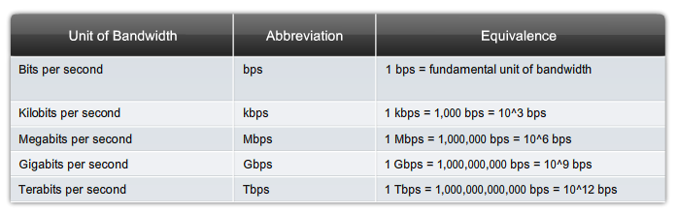
Fundamental Principles of Layer 1 Bandwidth
Notes:
Section 4.1.3.2

Slide 13
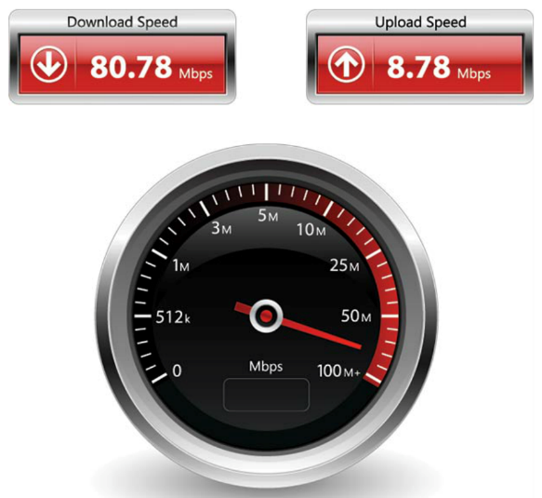
Fundamental Principles of Layer 1 Throughput
Notes:
Section 4.1.3.3

Slide 14
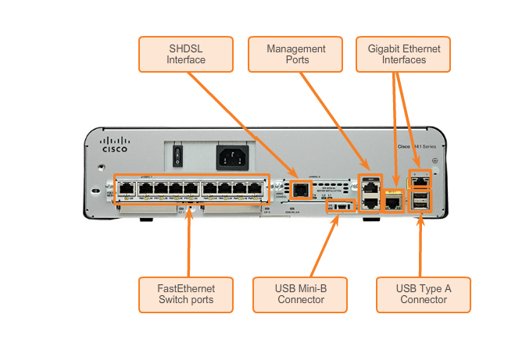
Fundamental Principles of Layer 1 Types of Physical Media
Notes:
Section 4.1.3.4

Slide 15
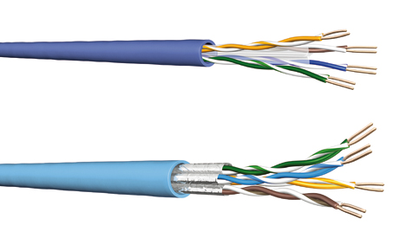
3.2 Network Media - Copper Cabling
Notes:
Section 4.2.1

Slide 16
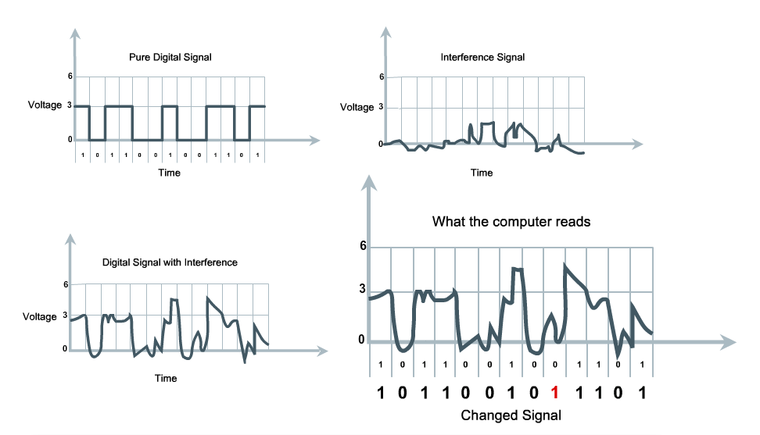
3.2 Network Media - Copper Cabling
Notes:
Section 4.2.1.1

Slide 17
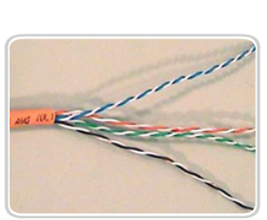
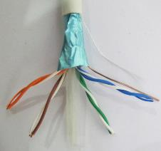

3.2 Network Media - Copper Cabling
Unshielded Twisted Pair (UTP) cable
Shielded Twisted Pair (STP) cable
Coaxial cable
Notes:
Section 4.2.1.2

Slide 18
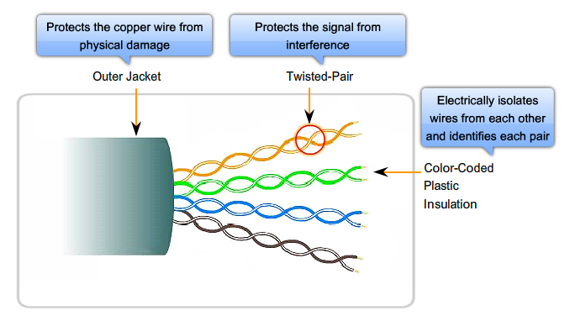
3.2 Network Media – Unshielded Twisted-Pair (UTP) Cable
Notes:
Section 4.2.1.3

Slide 19
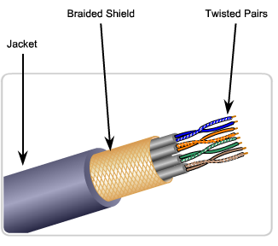
3.2 Network Media – Shielded Twisted-Pair (UTP) Cable
Braided or Foil Shield
Foil Shields
Notes:
Section 4.2.1.4

Slide 20
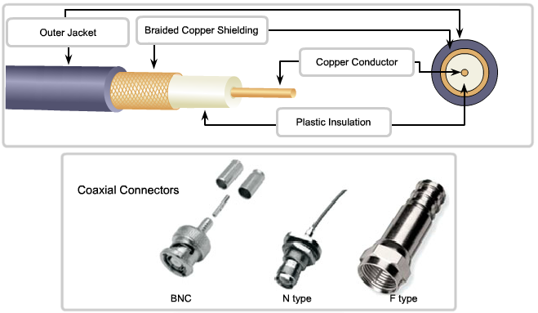
3.2 Network Media – Coaxial Cable
Notes:
Section 4.2.1.5

Slide 21
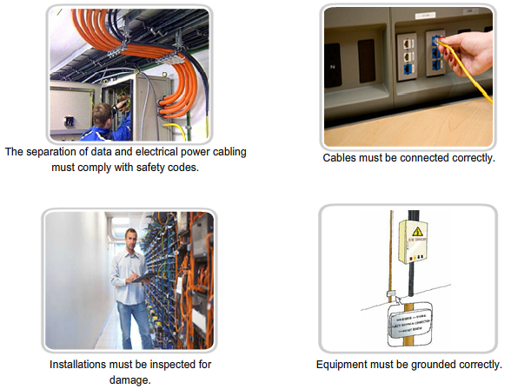
Copper Cabling Cooper Media Safety
Notes:
Section 4.2.1.6

Slide 22
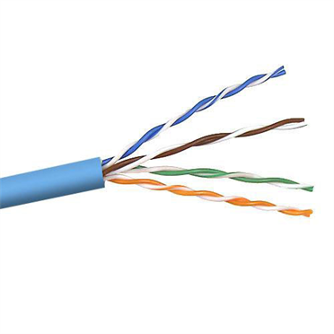
UTP Cabling Properties of UTP Cabling
Notes:
Section 4.2.2.1

Slide 23
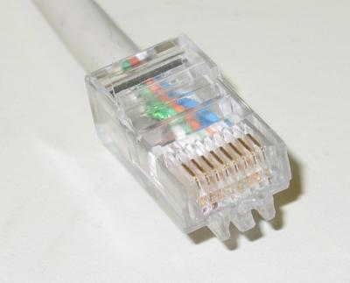
UTP Cabling UTP Connectors
Notes:
Section 4.2.2.3

Slide 24
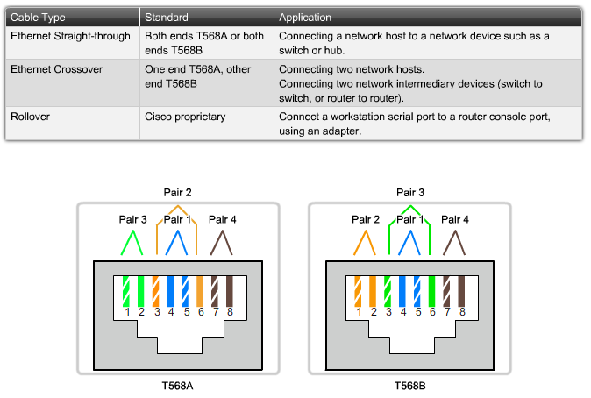
UTP Cabling Types of UTP Cable
Notes:
Section 4.2.2.4

Slide 25
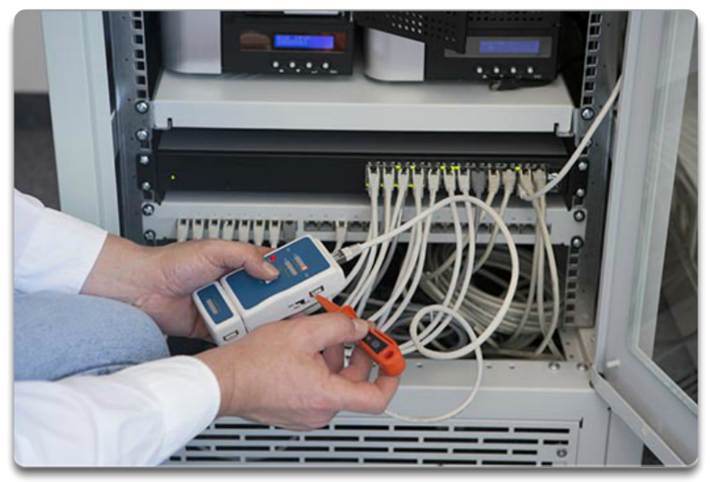
UTP Cabling Testing UTP Cables
Notes:
Section 9.4.2.6

Slide 26
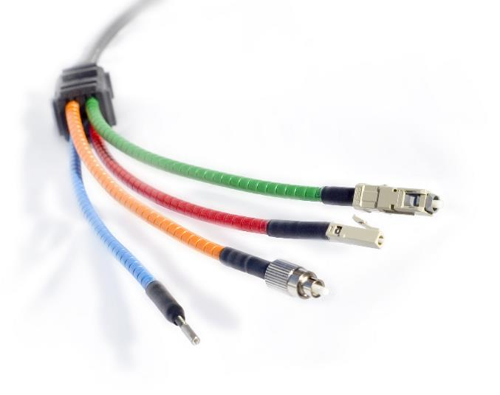
Fiber Optic Cabling Properties of Fiber Optic Cabling
Notes:
Section 4.2.3.1

Slide 27
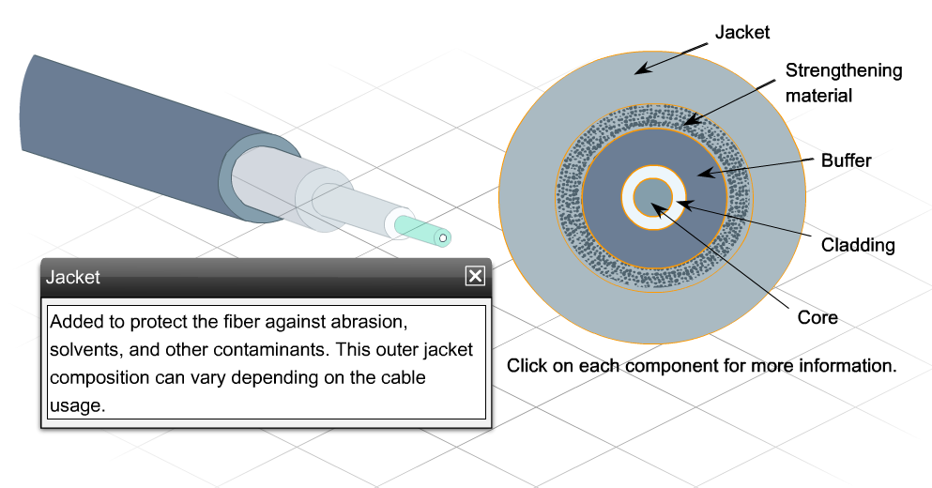
Fiber Optic Cabling Fiber Media Cable Design
Notes:
Section 4.2.3.2

Slide 28
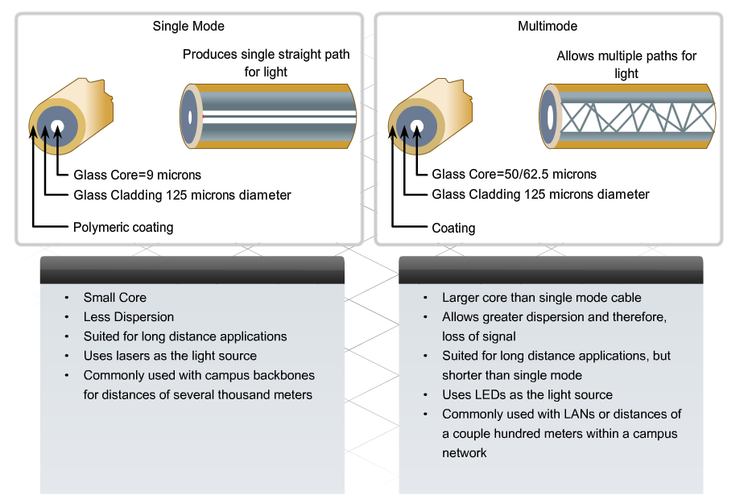
Fiber Optic Cabling Types of Fiber Media
Notes:
Section 4.2.3.3

Slide 29
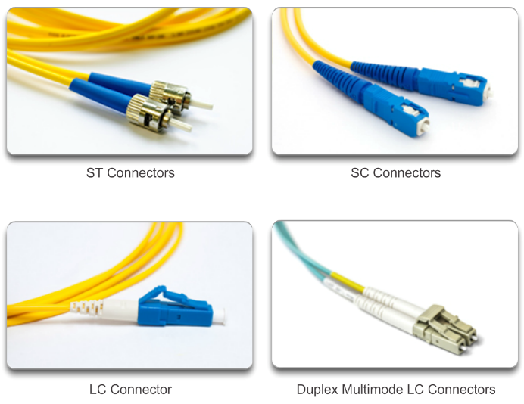
Fiber Optic Cabling Network Fiber Connectors
Notes:
Section 4.2.3.4

Slide 30
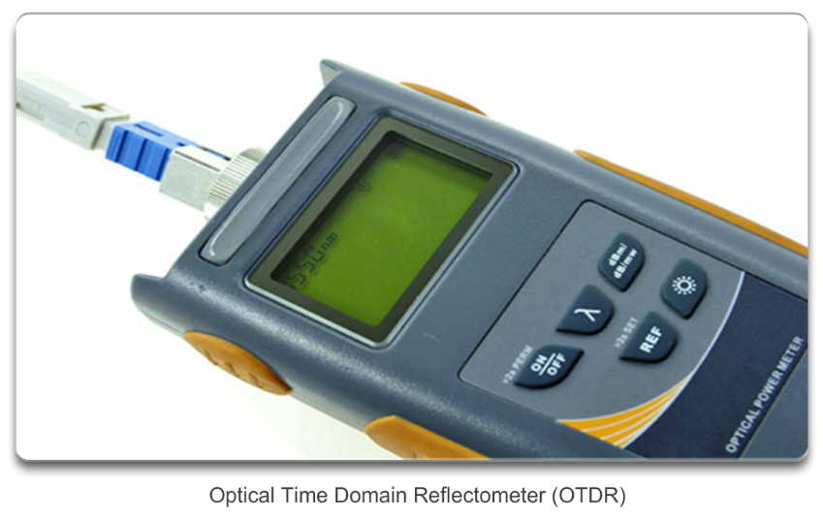
Fiber Optic Cabling Testing Fiber Cables
Notes:
Section 4.2.3.5

Slide 31
Fiber Optic Cabling Fiber versus Copper
Implementation issues | Copper media | Fibre-optic
Bandwidth supported | 10 Mbps – 10 Gbps | 10 Mbps – 100 Gbps
Distance | Relatively short (1 – 100 meters) | Relatively High (1 – 100,000 meters)
Immunity to EMI and RFI | Low | High (Completely immune)
Immunity to electrical hazards | Low | High (Completely immune)
Media and connector costs | Lowest | Highest
Installation skills required | Lowest | Highest
Safety precautions | Lowest | Highest
Notes:
Section 4.2.3.6

Slide 32
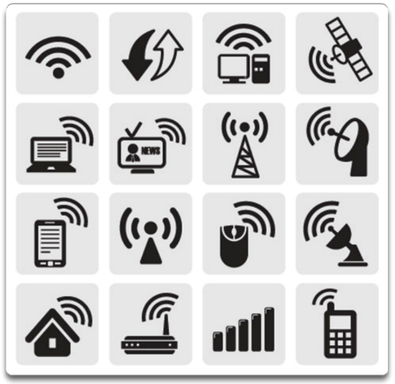
Wireless Media Properties of Wireless Media
Notes:
Section 4.2.4.1

Slide 33
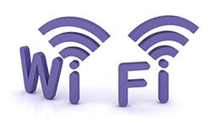


Wireless Media Types of Wireless Media
 | IEEE 802.11 standards Commonly referred to as Wi-Fi. Uses CSMA/CA Variations include: 802.11a: 54 Mbps, 5 GHz 802.11b: 11 Mbps, 2.4 GHz 802.11g: 54 Mbps, 2.4 GHz 802.11n: 600 Mbps, 2.4 and 5 GHz 802.11ac: 1 Gbps, 5 GHz 802.11ad: 7 Gbps, 2.4 GHz, 5 GHz, and 60 GHz
 | IEEE 802.15 standard Supports speeds up to 3 Mbps Provides device pairing over distances from 1 to 100 meters.
 | IEEE 802.16 standard Provides speeds up to 1 Gbps Uses a point-to-multipoint topology to provide wireless broadband access.
Notes:
Section 4.2.4.2

Slide 34
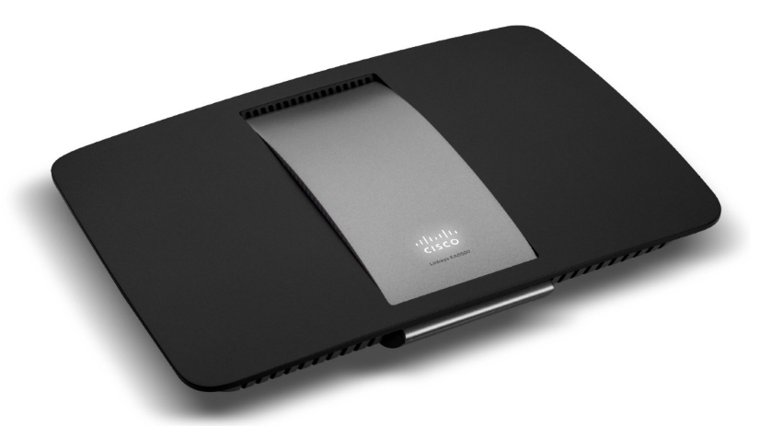
Wireless Media Wireless LAN
Cisco Linksys EA6500 802.11ac wireless router
Notes:
Section 4.2.4.3

Slide 35
Wireless Media 802.11 Wi-Fi Standards
Standard | Maximum Speed | Frequency | Backwards compatible
802.11a | 54 Mbps | 5 GHz | No
802.11b | 11 Mbps | 2.4 GHz | No
802.11g | 54 Mbps | 2.4 GHz | 802.11b
802.11n | 600 Mbps | 2.4 GHz or 5 GHz | 802.11b/g
802.11ac | 1.3 Gbps (1300 Mbps) | 2.4 GHz and 5.5 GHz | 802.11b/g/n
802.11ad | 7 Gbps (7000 Mbps) | 2.4 GHz, 5 GHz and 60 GHz | 802.11b/g/n/ac
Notes:
Section 4.2.4.4

Slide 36
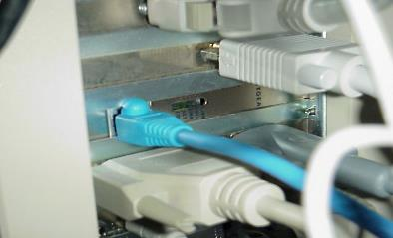
Straight-through cables
Switch to router
Switch to PC/server
Hub to PC/server
Lab environment→ socket (different installation)

Slide 37
Crossover cable
Switch to switch
Hub to hub
Router to router
PC to PC (NIC to NIC)
Switch to hub
Router to PC

Slide 38

Exercise 1.1.5.3: Cabling Devices

Slide 39
Network Access Summary
Physical Layer Protocols
Network Media
Notes:
Section 4.5

Slide 40


